Slide 1


roomie
Tinder Style Roommate Finder App
Notes:
Mahita

Slide 2


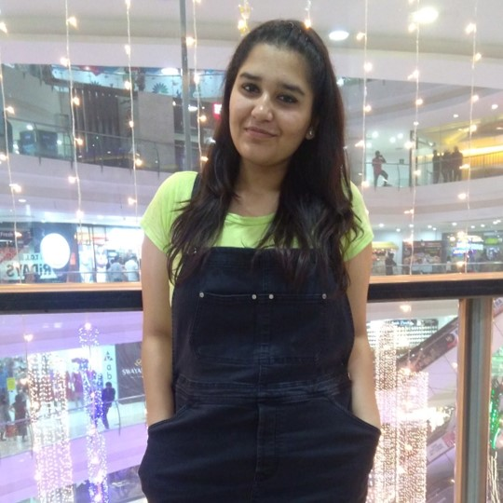
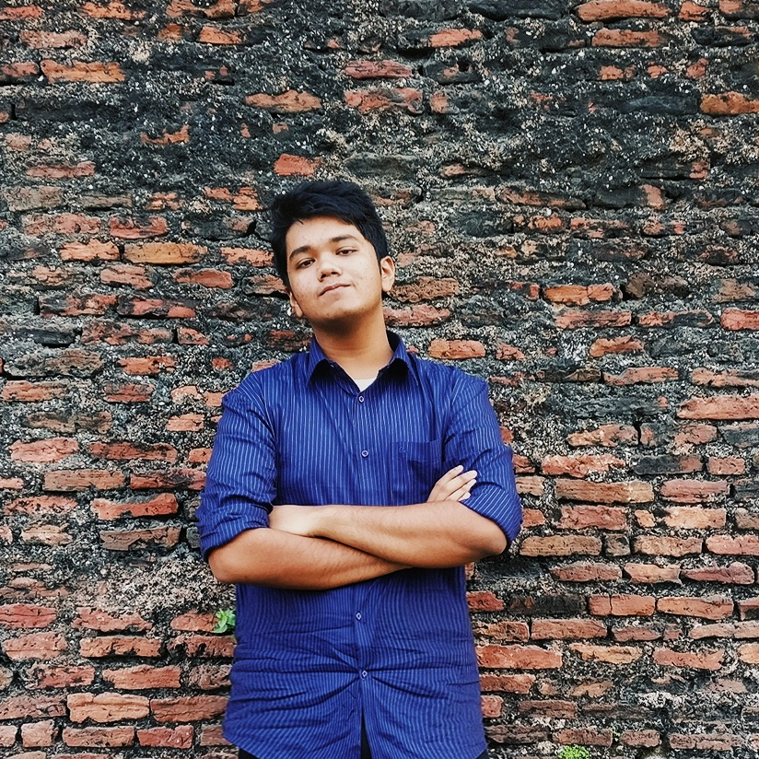
meet the team
Saharsh Vedi
Application Developer
Mahita Tatavarthy
Business Designer
Hirali
Patel
Product
Owner
Tapasya Sharma
Data Analyst
Ahnaf An Nafee
Scrum
Master / Developer

Slide 3
original
project
scope
An app which helps you find roommates
Tinder style swipe to accept or reject
Let them chat on the app after they are matched
Notes:
Mahita

Slide 4
tools used
GitHub
GroupMe for communication
Android Studio
Adobe XD
Trello for Scrum Board
Firebase
Notes:
Tapasya
-Experience with these tools, including lessons learned

Slide 5
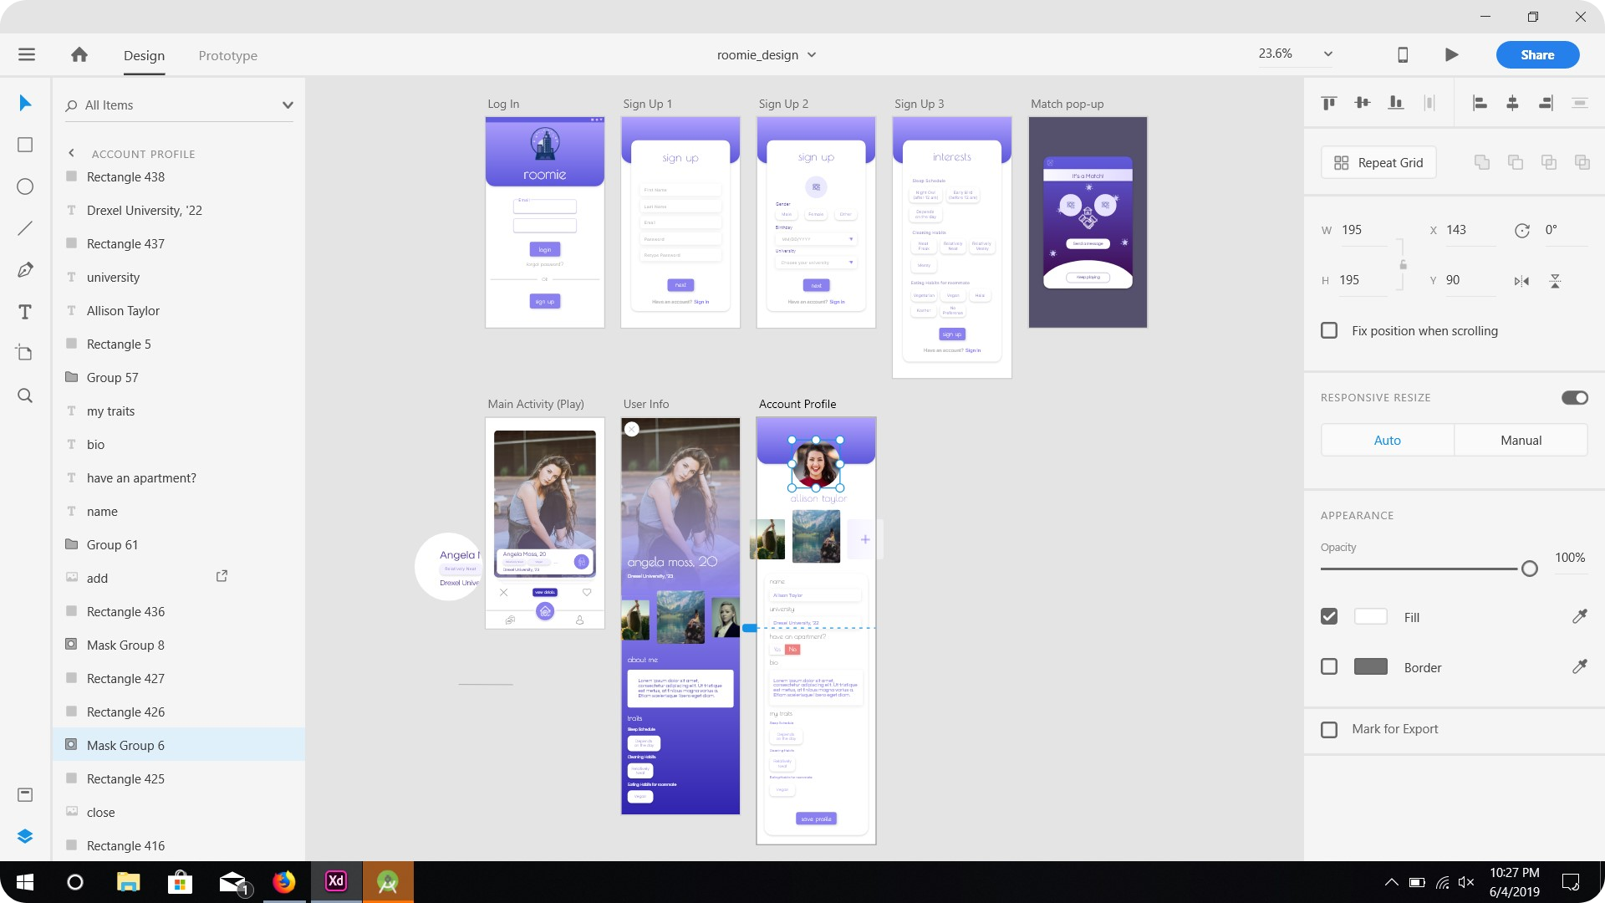
adobe XD
Notes:
Ahnaf
-Started out by creating design mockups in Adobe XD
-Collaborated with the team to come to a final design and implemented it in XML
-All initial designing was done in Adobe XD to create accuracy in execution during actual user interface design

Slide 6
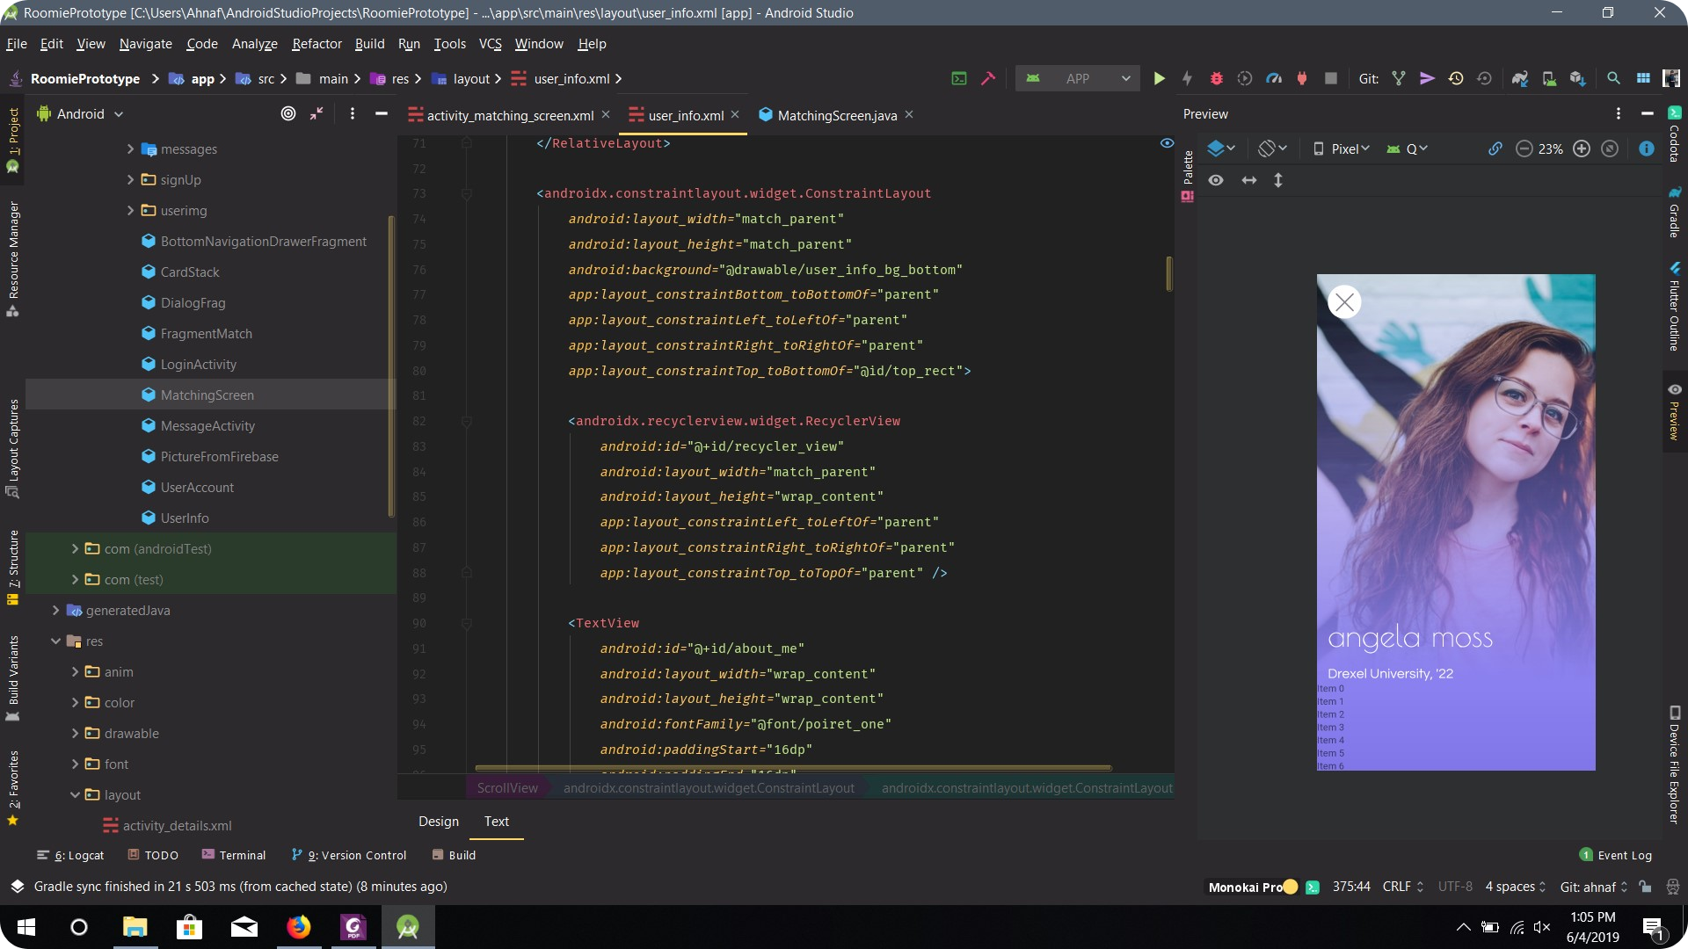
android studio (design)
Notes:
Ahnaf
-Used my adobe XD designs to create the design XMLs and through trial and error, connected the different elements in the user interface and made them functional with the respective java code
-Faced lots of issues with the design rendering primarily due to bugs in android studio but was resolved through heavy research (stackoverflow and google issue tracker)
-Was involved in designing all the screens and making it user friendly with a pleasant design.

Slide 7
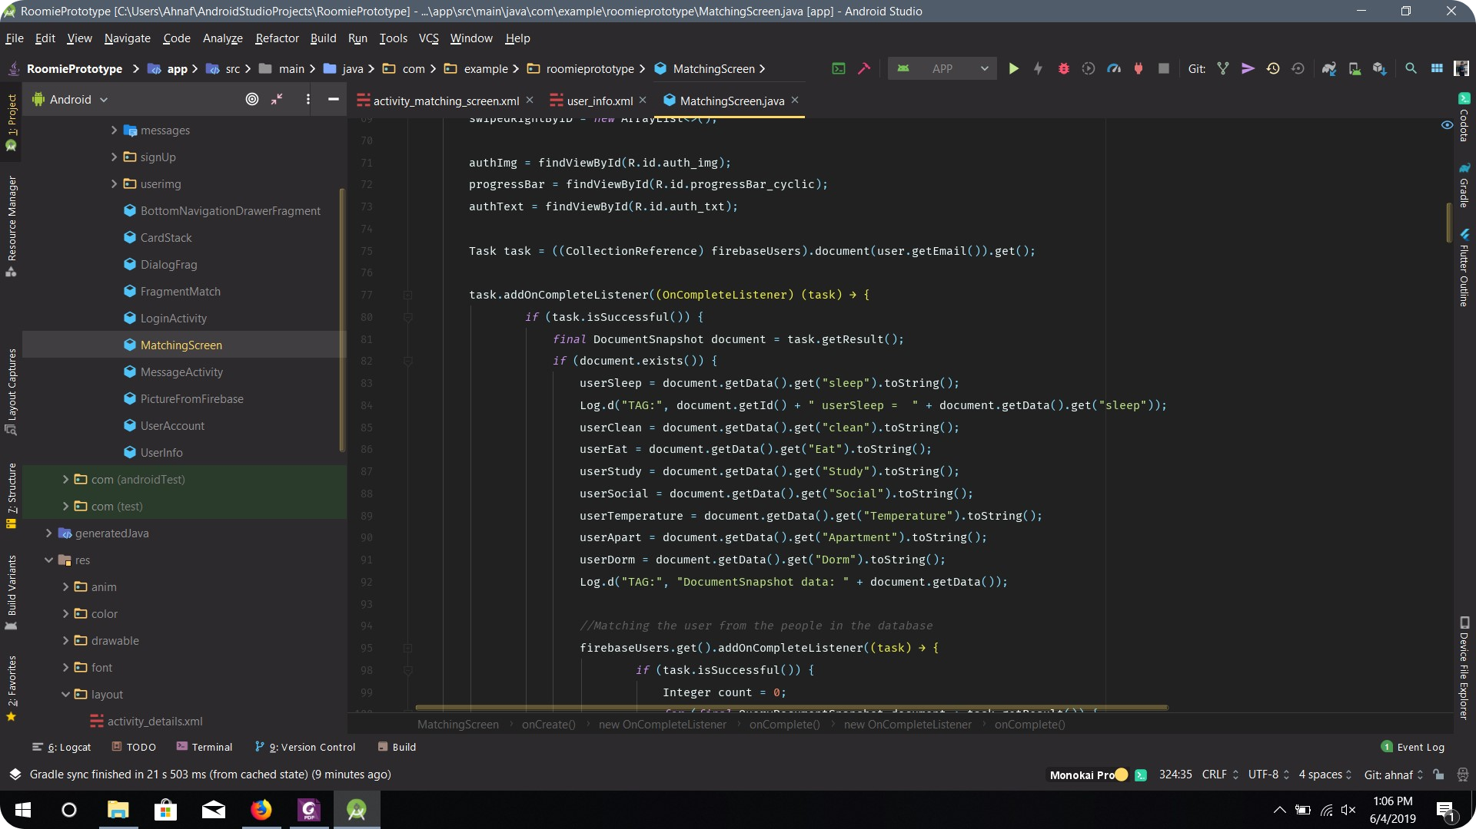
android studio (code)
Notes:
Saharsh
-Autocomplete and suggestions and bad coding and also realtime errors

Slide 8
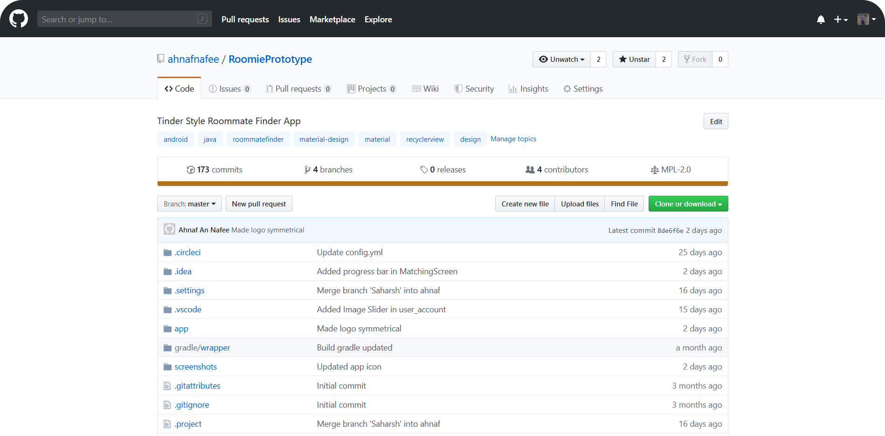
repository
android studio (code)
Notes:
Ahnaf
-Hosted the entire project in Github using the Mozilla Public License 2.0.
-Used branches to collaborate and keep sync with the workflow

Slide 9
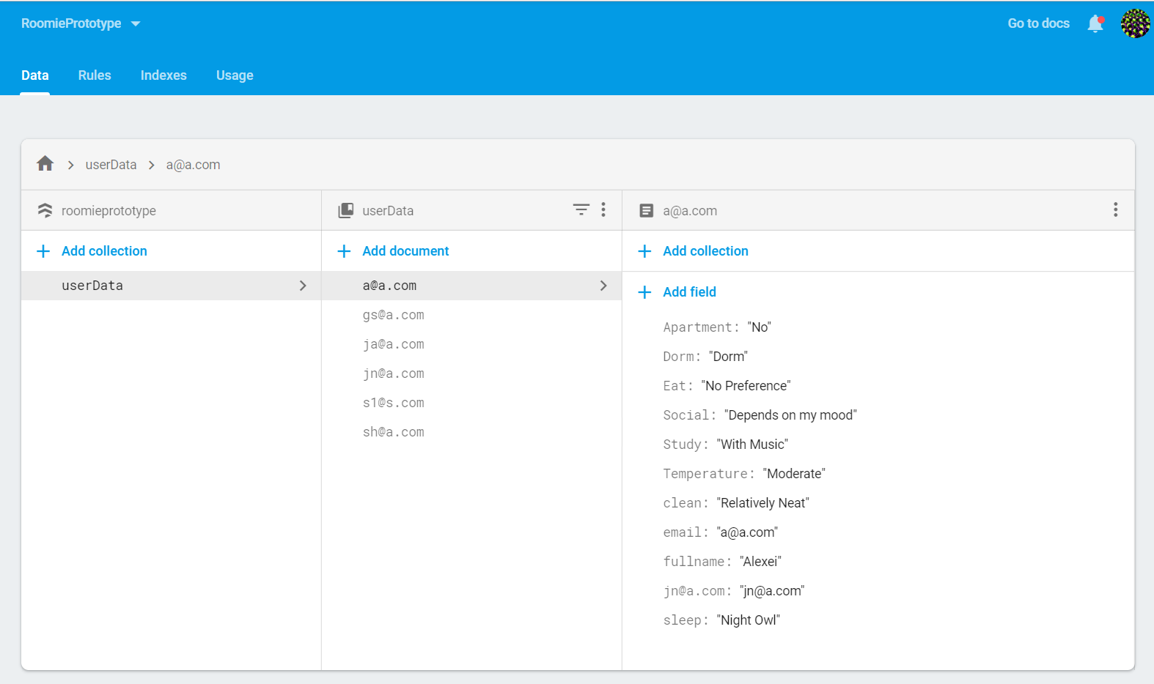
firestore
Notes:
Saharsh

Slide 10
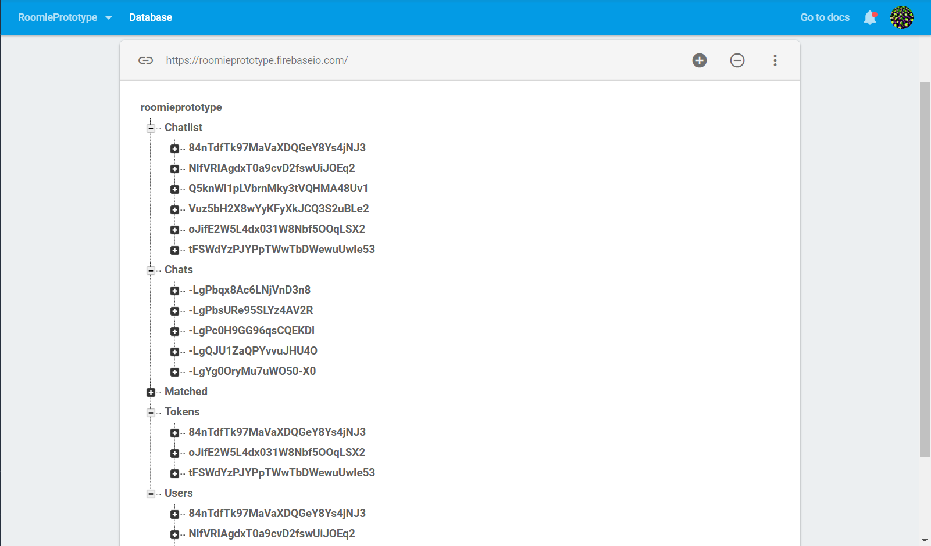
realtime database
Notes:
Ahnaf
-Reason for also using the realtime database was to get user messages to and fro in real time
-We implemented a messaging feature that allows user to send messages to each other once matched and the real time updates allow for fluent communication

Slide 11
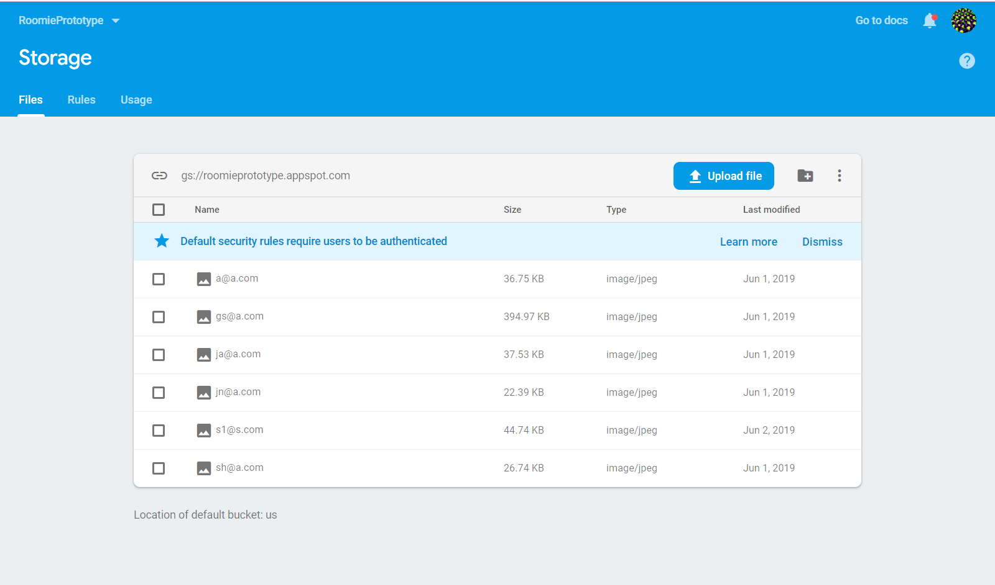
firebase storage
Notes:
Ahnaf
-Stores primarily the user photos

Slide 12
communication
The team met every Tuesday.
The team also used GitHub to branch, share and merge code on a regular basis.
All actively participated in GroupMe
Used the group chat to answer questions and discuss meeting times
Notes:
Mahita
-Experience with these tools, including lessons learned
Learned how to communicate effectively and also learned both the positive and negatives of GitHub
Positives: branches
Negatives: merge conflicts - when we were trying to merge onto the master branch, it would ask which version of the code we wanted on the master branch - a little inconvenient

Slide 13
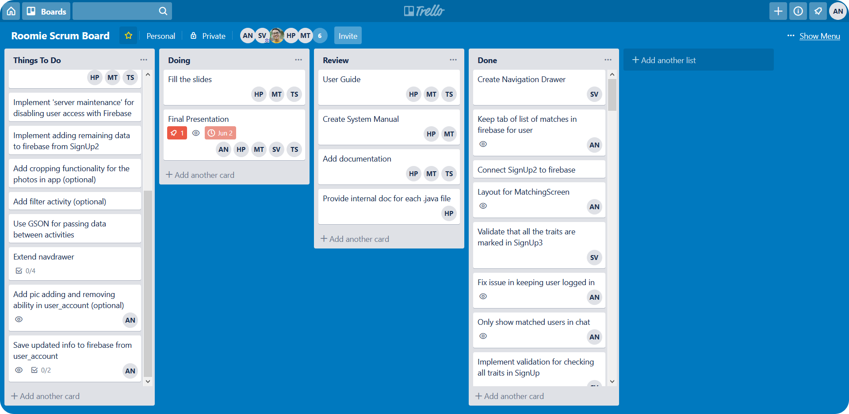
scrum board
Notes:
Tapasya
-Experience with these tools, including lessons learned
Overall, trello fit the requirements we needed. At times it was messy because of the immense amount of tasks but it did visually showcase our progress.

Slide 14
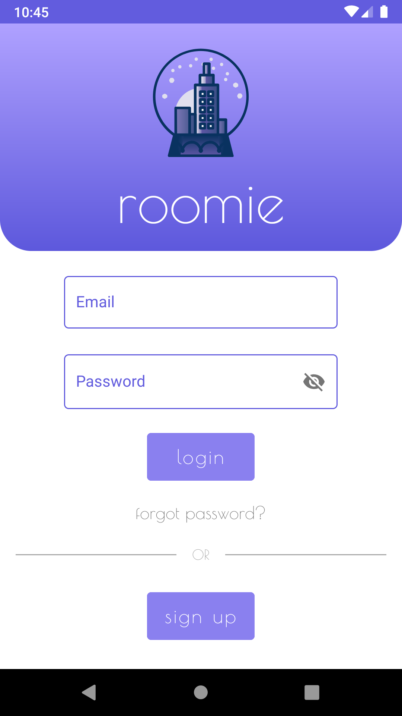
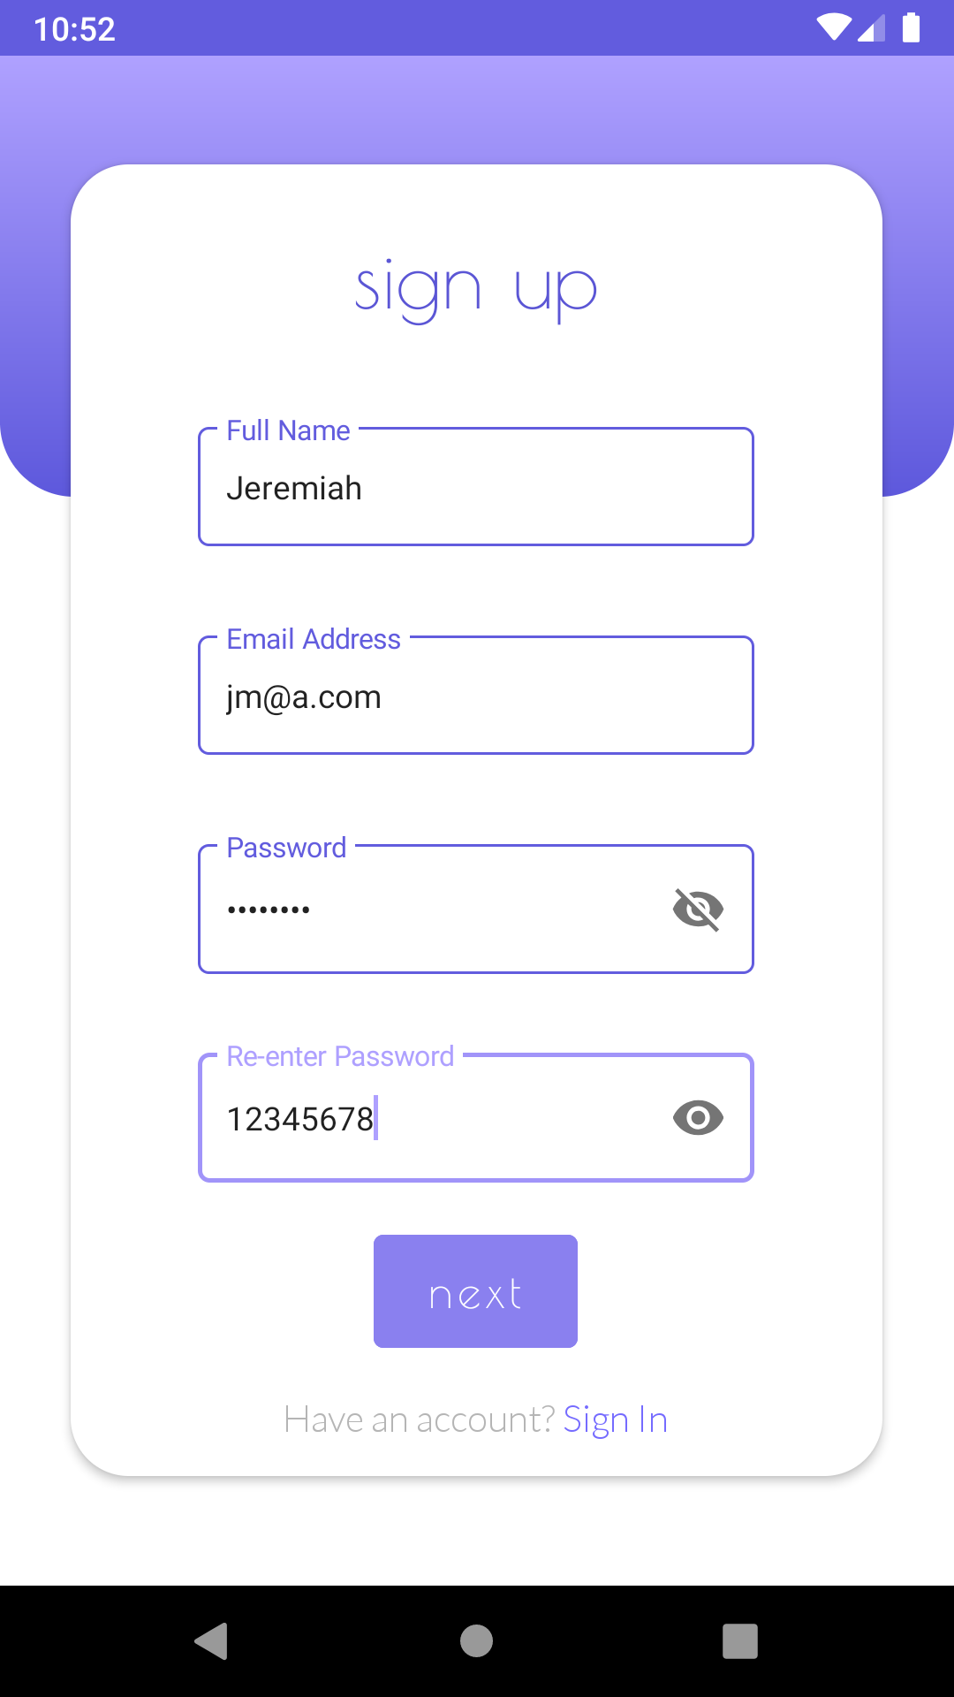
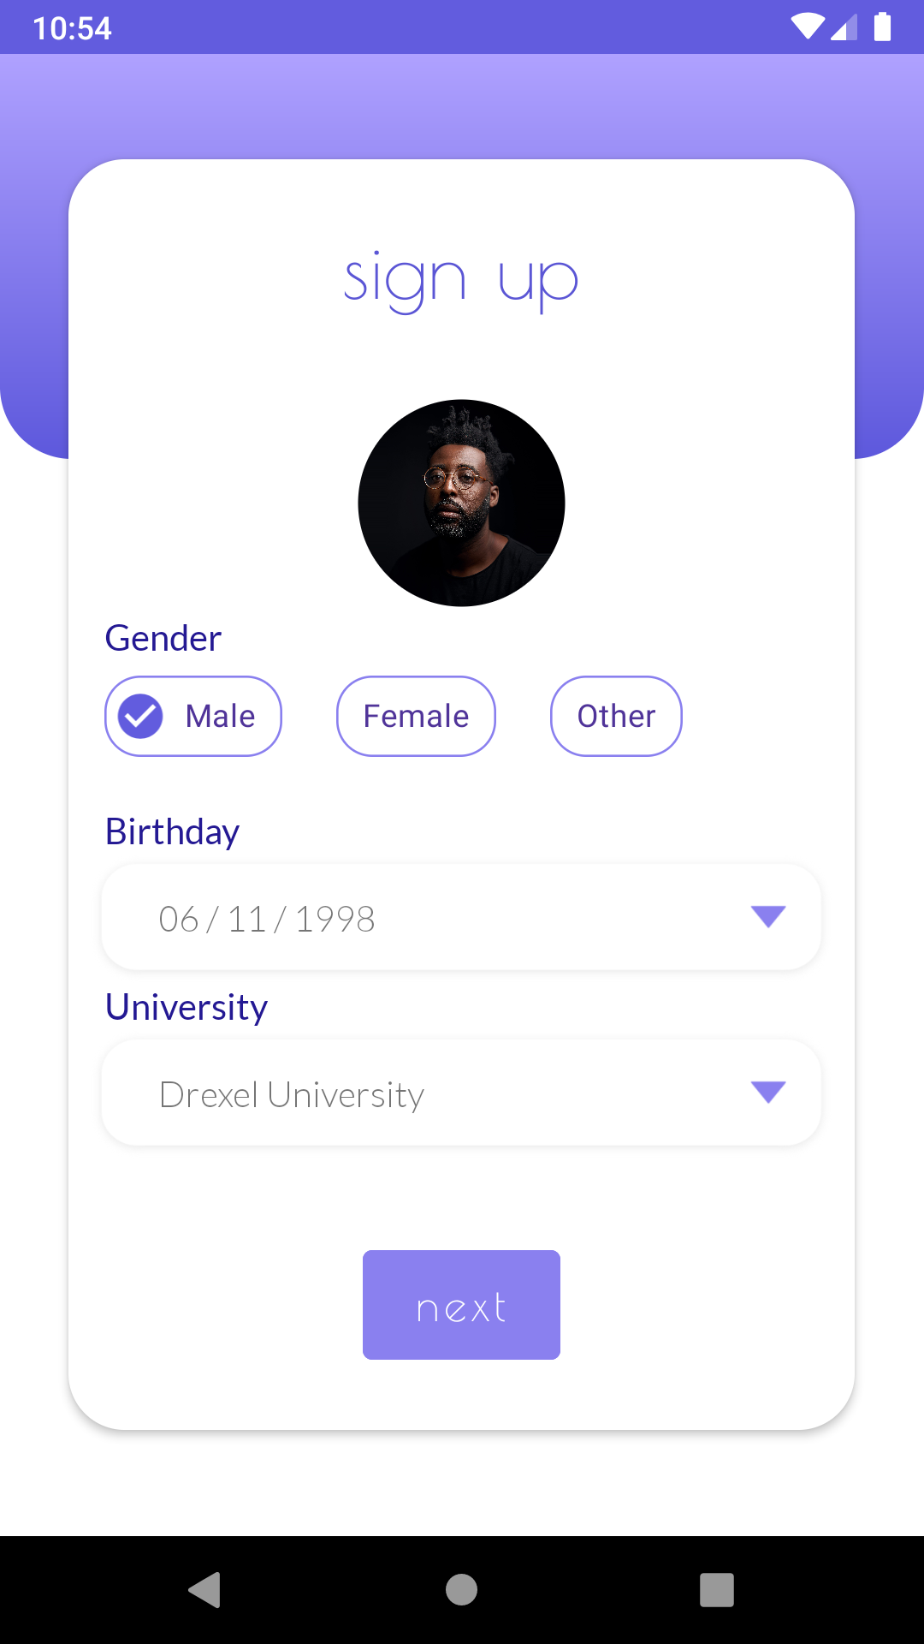
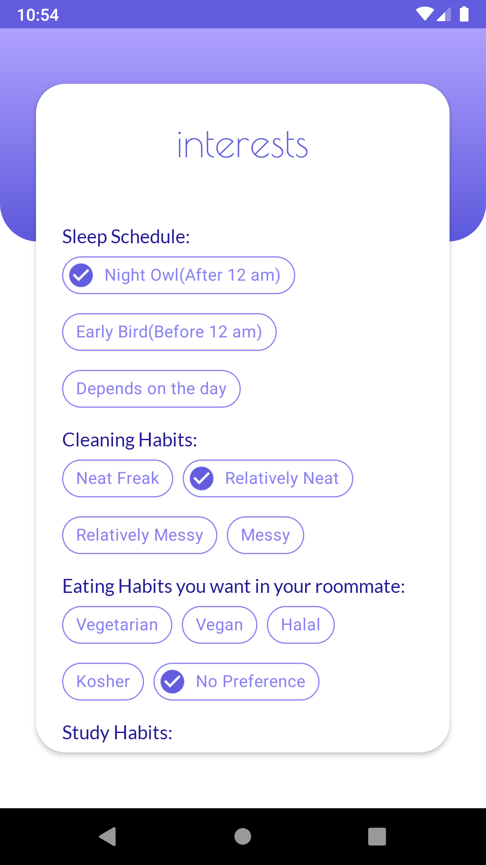
login page & sign up

Slide 15
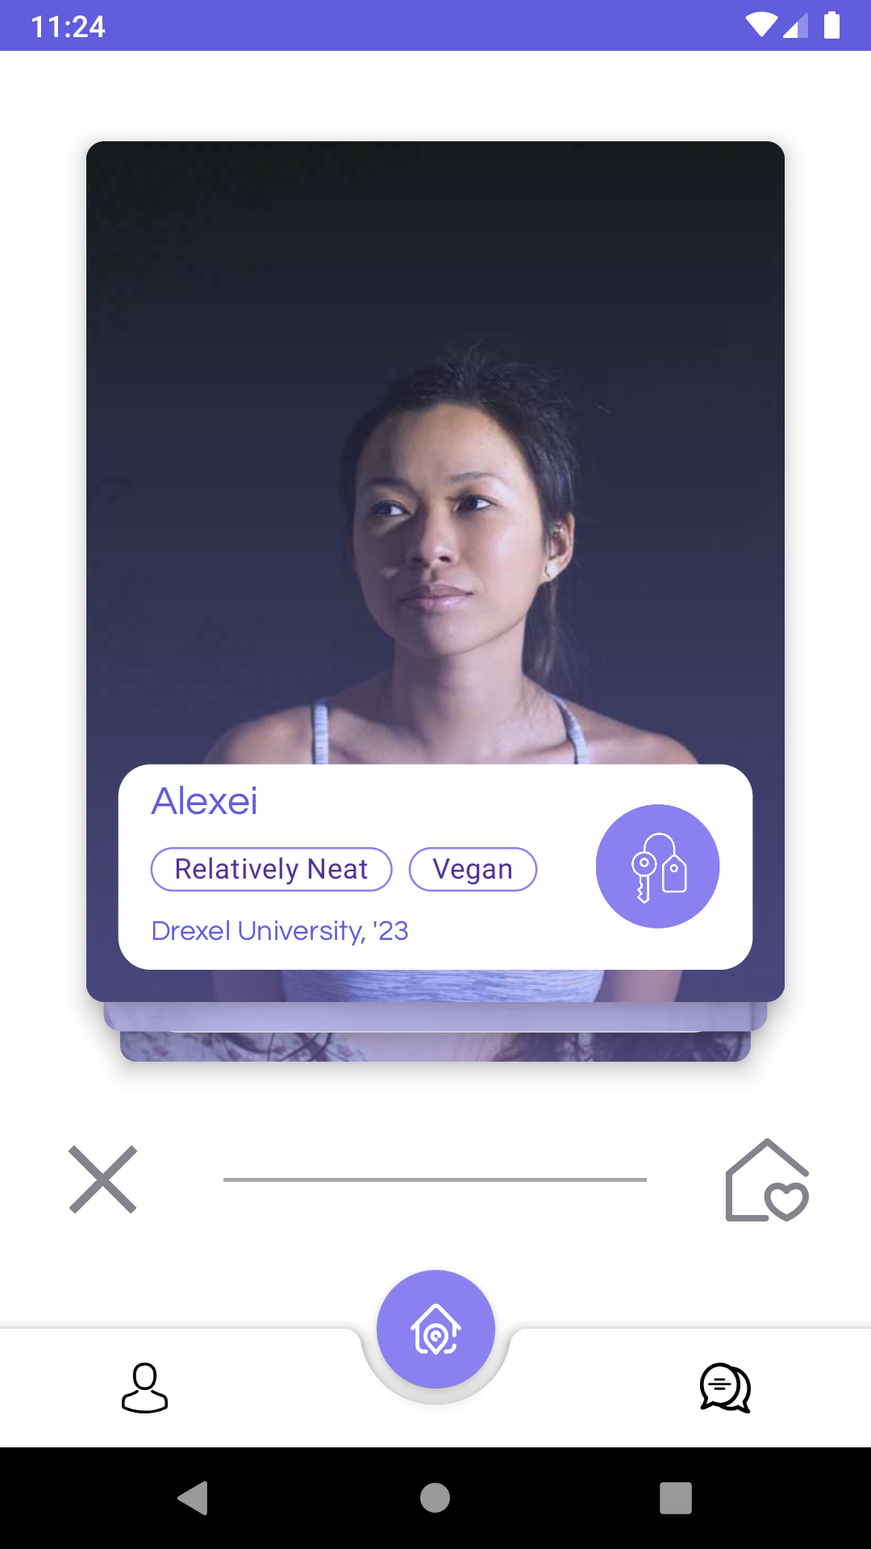
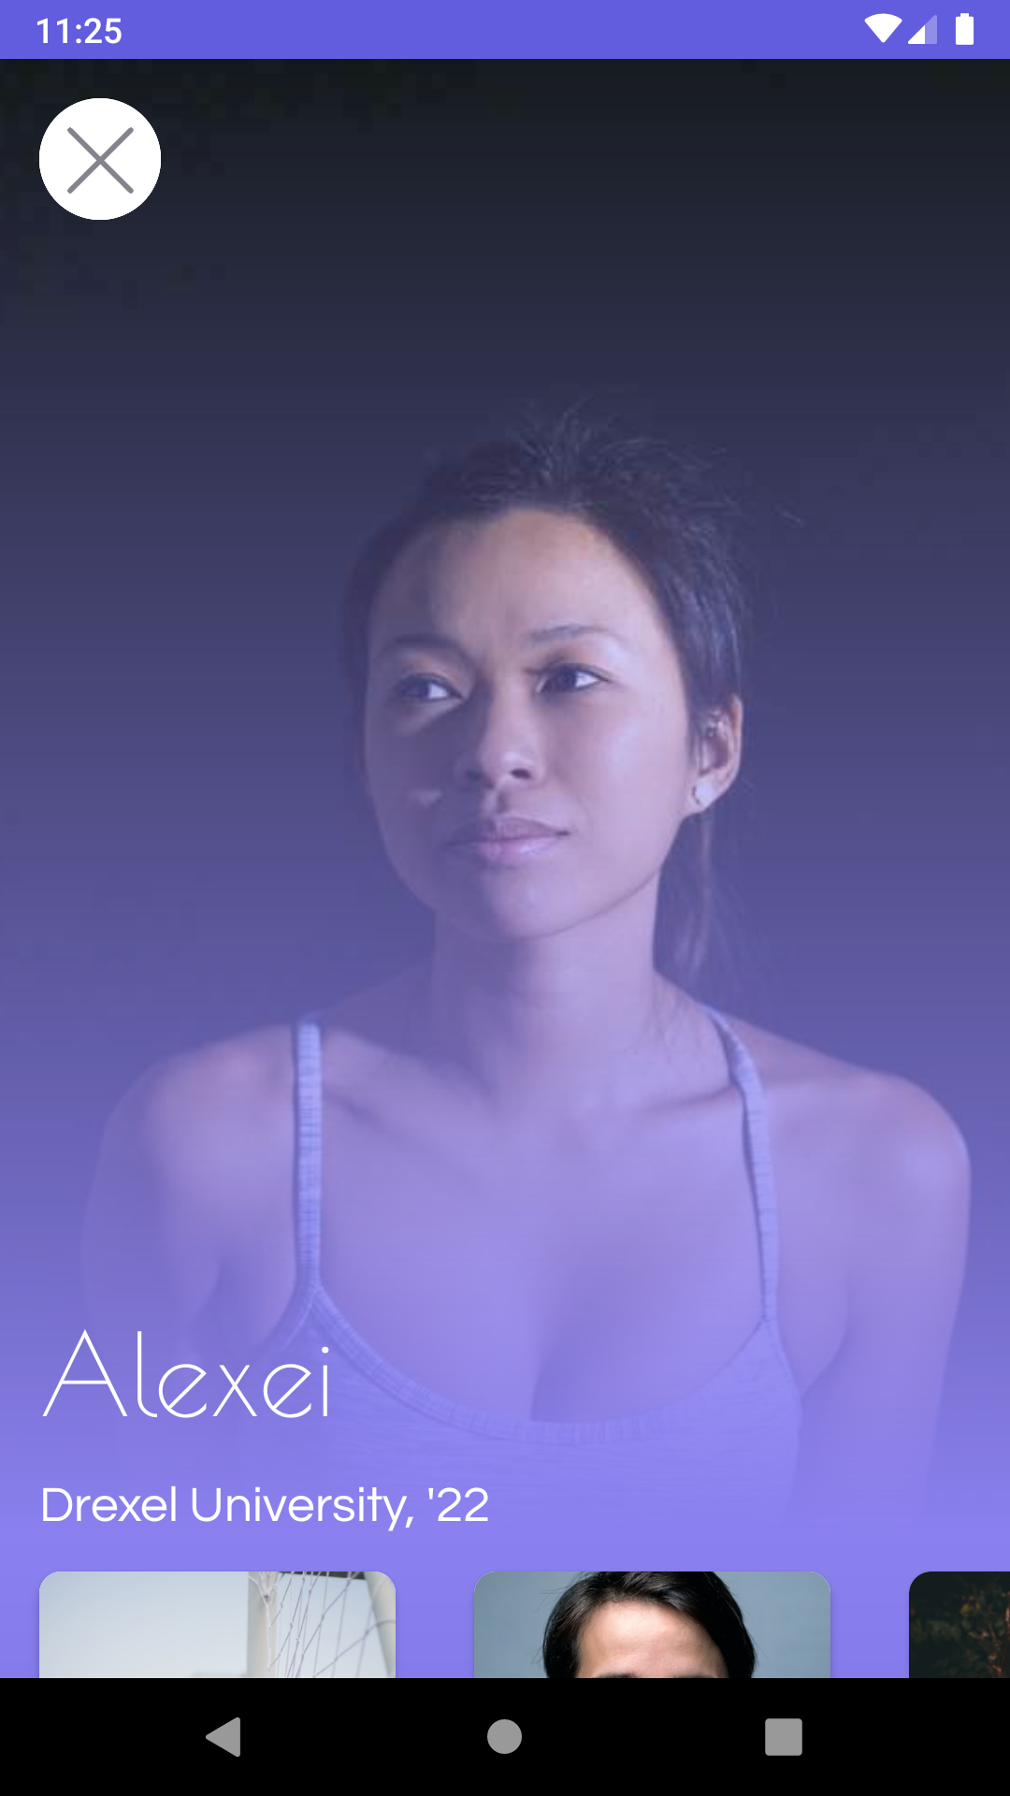
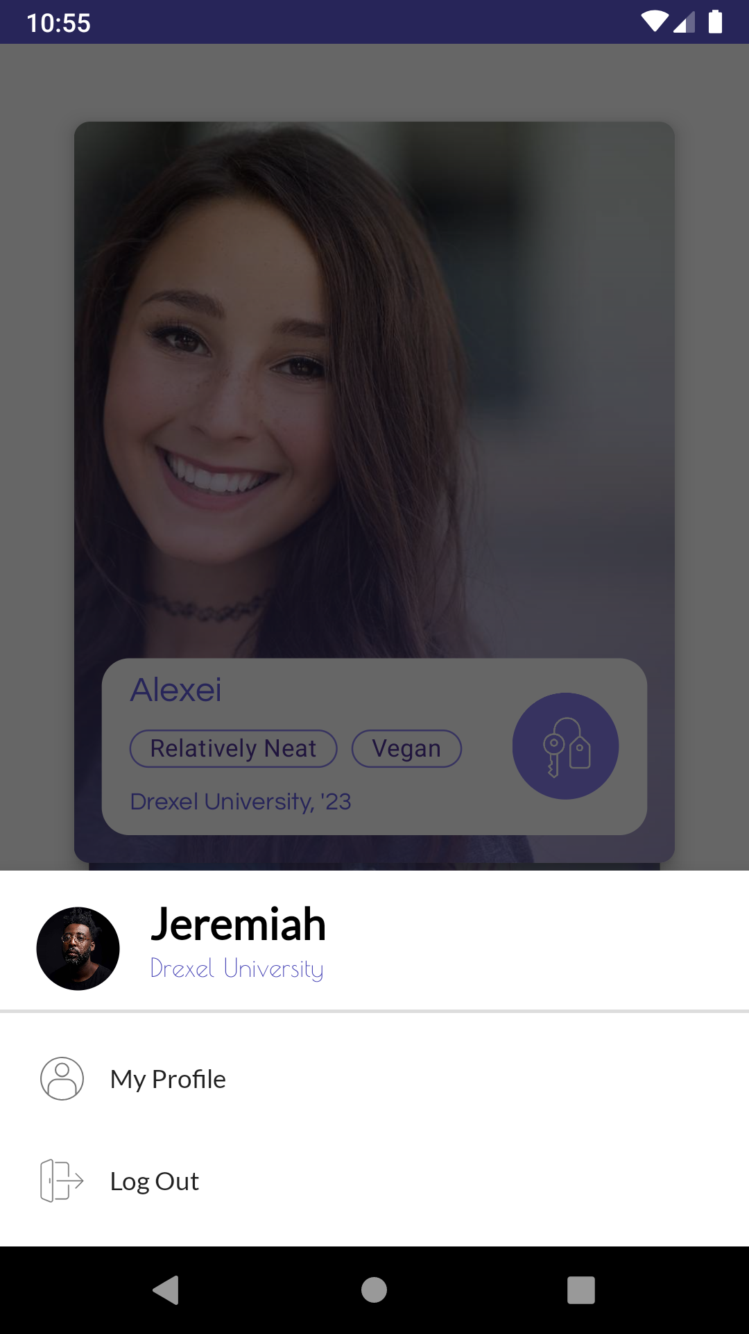
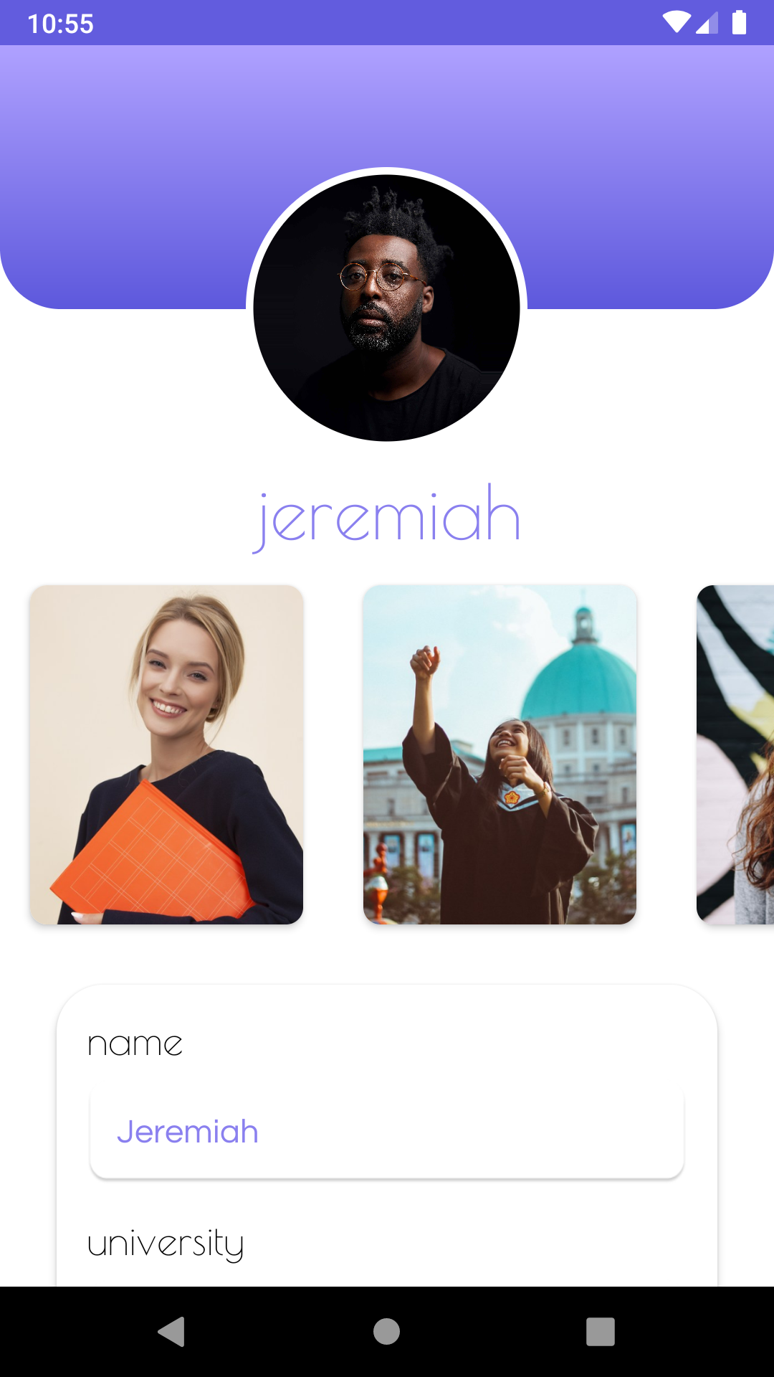
main activity & profile

Slide 16
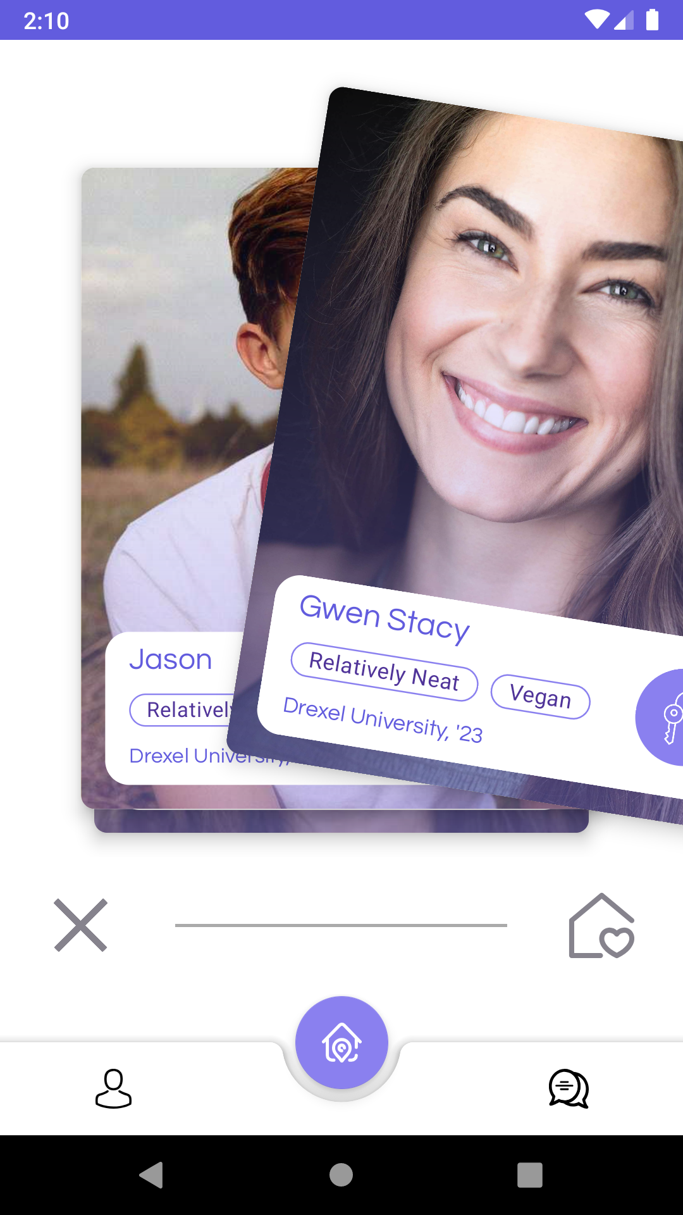
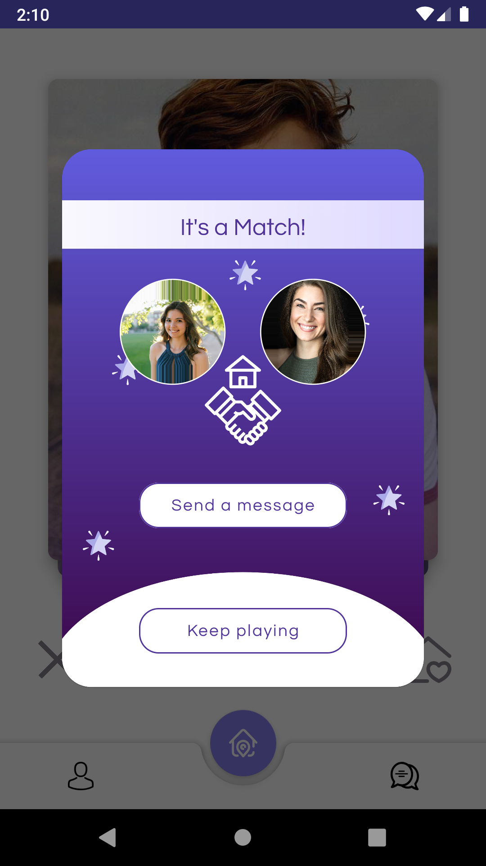
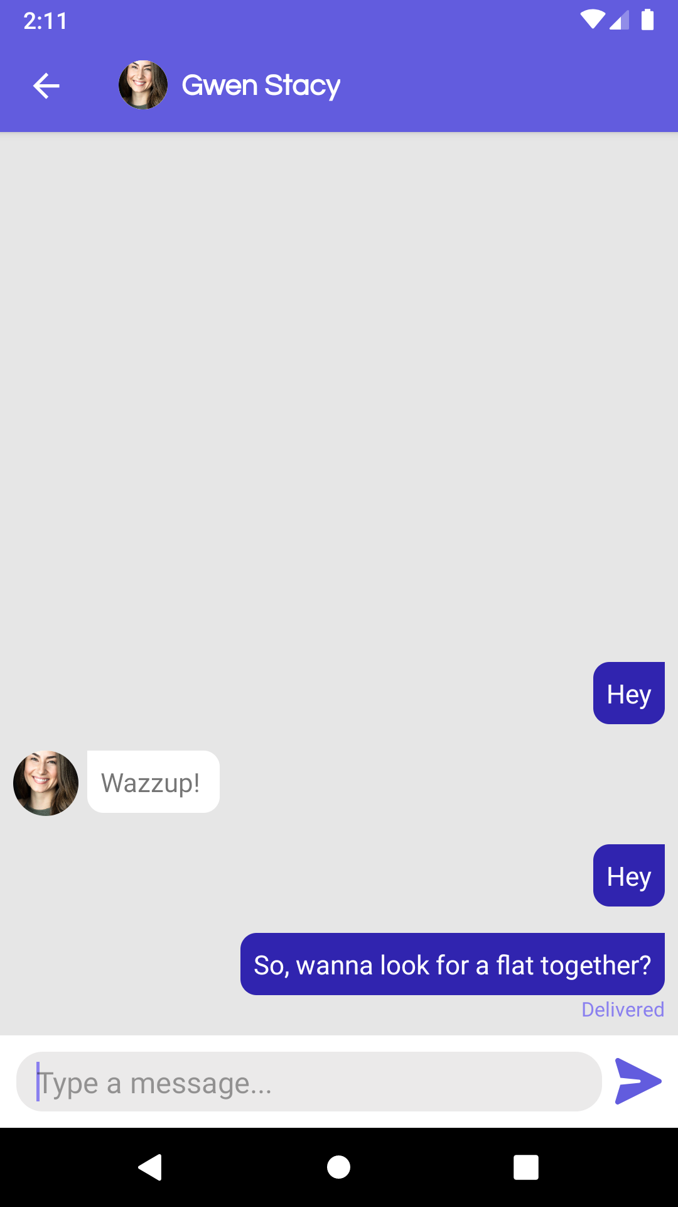
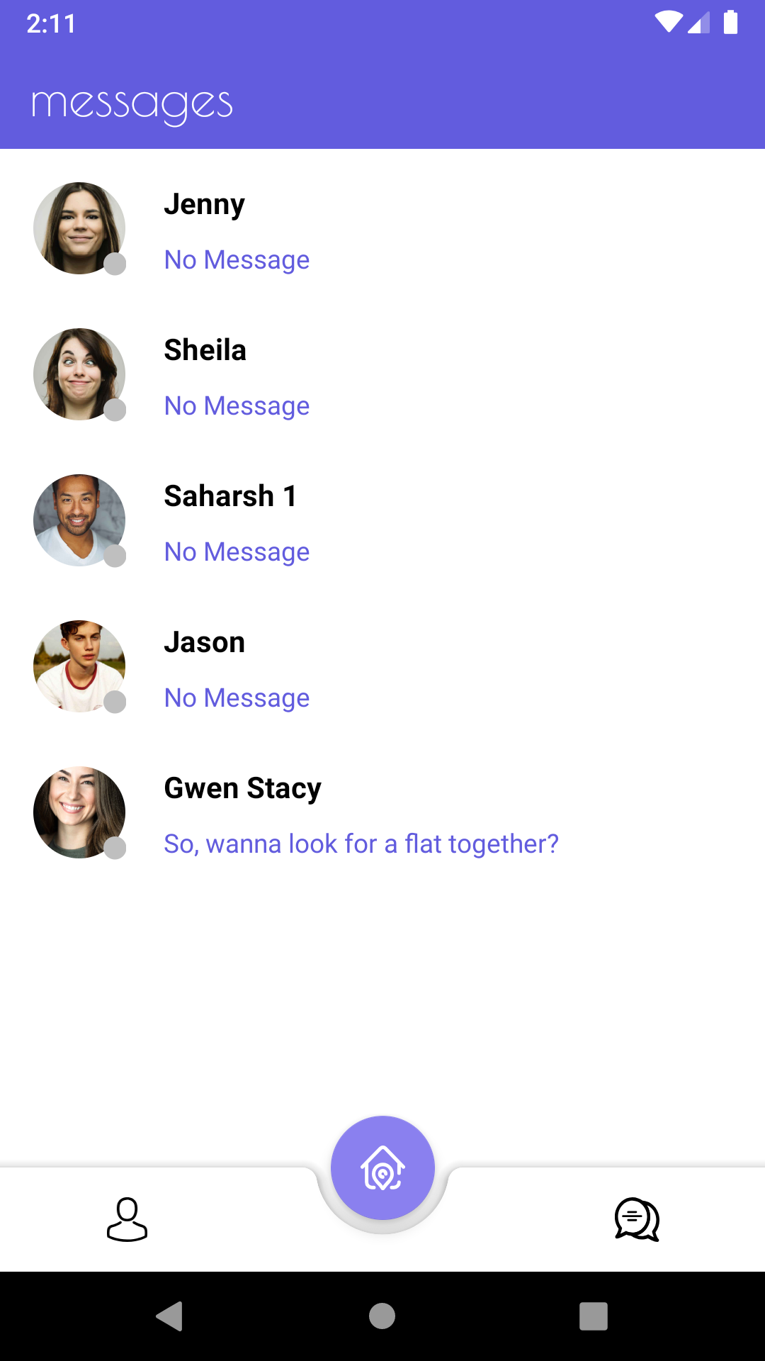
main activity & messaging

Slide 17
demo
Notes:
Hirali

Slide 18
video
demo
Notes:
Hirali

Slide 19

original
project
scope
An app which helps you find roommates
Tinder style swipe to accept or reject
Let them chat on the app after they are matched
Notes:
Tapasya
As seen from the demo, we completed our original project scope!

Slide 20
personal gain
Notes:
All
Hirali:
creativity, teamwork, time management
GitHub, android studios
Mahita:
First time seeing the process of developing an app
Collaboration and planning the process
GitHub
Tapasya
Ahnaf
Started out with no experience in Android Development 2 months ago
Now have become proficient in designing user interfaces in XML and also coding complex functions in java for both frontend and backend
Benefited as I got to ecampnd my knowledge base immensely
Saharsh:
Github

Slide 21
Thanks!
Any questions?
Notes:
Mahita

